Slide 1








Understanding the Impacts of Renewable Energy and Infrastructure Loads on Food-Energy-Water Security in Remote Arctic Communities
American Geophysical Union Fall 2018 Meeting
Panel Session GC52B: The Food–Energy–Water System Nexus and Decision Support for Sustainability I
Paper number: GC52B-07
December 14, 2018
Presenting Author: Richard Wies^{1,2,3}
Project Team: Srijan Aggarwal⁵, Aaron Dotson⁶, Craig Gerlach⁷, Daisy Huang^{3,4}, Justus Karenzi^{1,2}, Henry Penn⁷, Christopher Pike³, Daniel Sambor⁸, Erin Whitney³
University of Alaska Fairbanks - ¹Electrical and Computer Engineering, ²Institute of Northern Engineering, ³Alaska Center for Energy and Power, ⁴Mechanical Engineering, ⁵Civil Engineering
⁶University of Alaska Anchorage - Civil Engineering
⁷University of Calgary – Arctic Institute of North America
⁸Stanford University - Civil and Environmental Engineering, Atmosphere/Energy Program
This work is supported by NSF Chemical, Bioengineering, Environmental and Transport Systems (CBET), Track 3 INFEWS program, Award # 1740075,
INFEWS/T3: Coupling infrastructure improvements to food-energy-water system dynamics in small cold region communities: MicroFEWs.

Slide 2
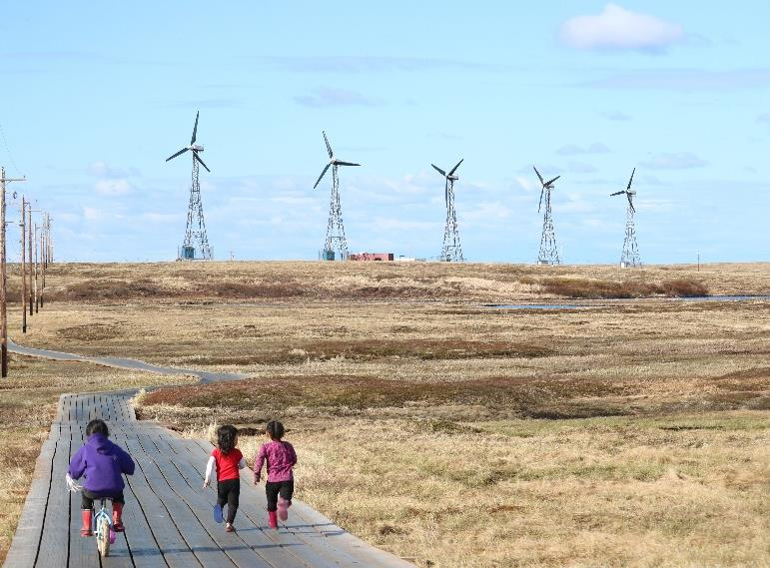
OUTLINE
MicroFEWs Project Description
Research Questions
Alaska’s Remote Islanded Microgrids
Stakeholder Community Energy Systems
Energy Distribution Model/ Simulation
Lab Testing and Validation
Status and Path Forward

Slide 3
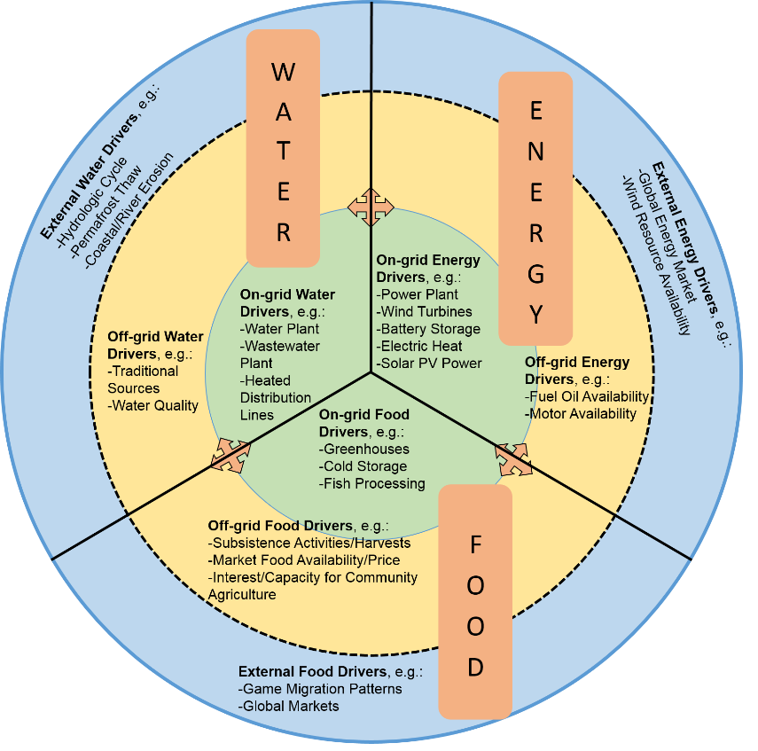
MicroFEWS Project Description
Coupling infrastructure improvements to food-energy-water system dynamics in small cold region communities: MicroFEWs
Engage communities
Identify connections between renewables and FEWS infrastructure
Optimization of renewables driving FEWS loads
FEWS loads
Food production
Water treatment
Modular systems
Dispatchable?
Enhance FEW security in remote islanded microgrids

Slide 4
MicroFEWS Project Description
Research Questions:
1) What are the direct and indirect linkages and feedbacks between renewable energy generation and the local drivers of food, energy, and water (FEW) security in Arctic and Subarctic communities?
2) To what extent can combinations of renewable energy generation and FEW-related infrastructure energy loads be optimized to enhance FEW security in Arctic and Subarctic communities?
Results for Scientific Community
Results for Community Planning

Slide 5
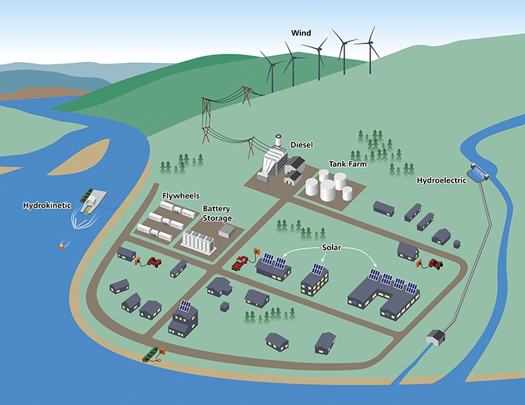
Remote Islanded Microgrids
Firm generation
Intermittent generation
Energy storage
Demand Response

Slide 6
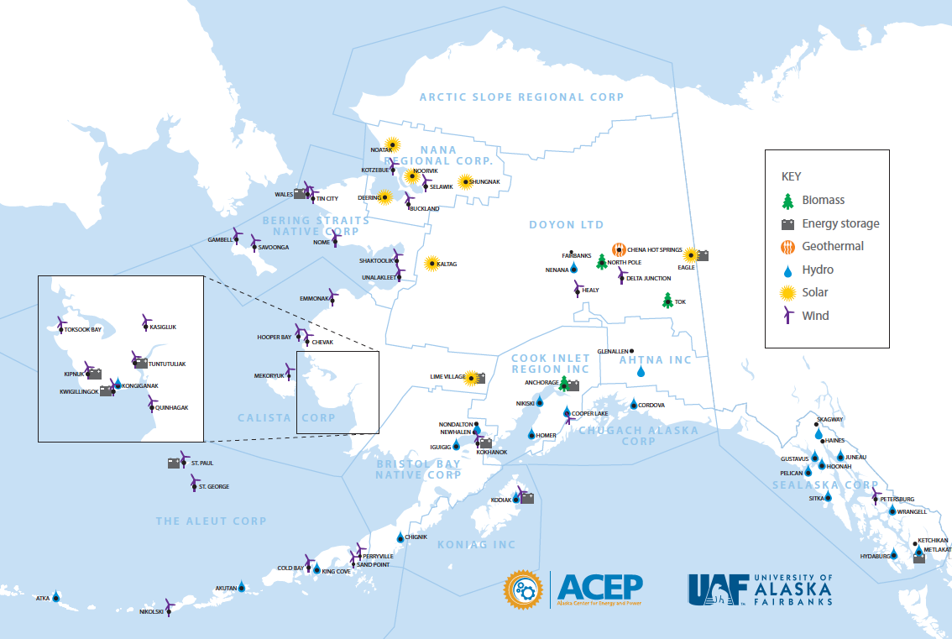
Alaska’s Remote Islanded Microgrids
70 of ~200 Alaska RIMs use renewable energy sources
Alaska has ~12% of the worlds microgrids that incorporate grid scale renewable resources. (data from Navigant Research)

Slide 7
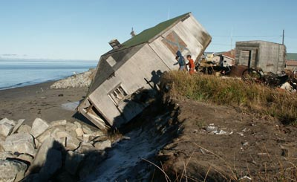
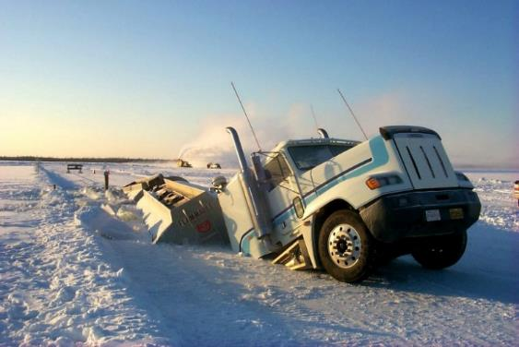
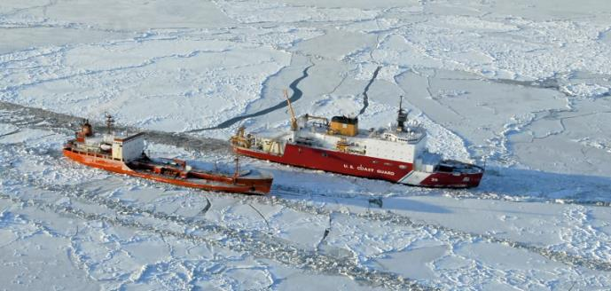
Alaska Islanded Grid Realities
Harsh and changing climate
End of supply lines
Dispersed population
Limited road network
Erosion from fall storms - Shishmaref
Limited fuel delivery on ice roads
Icebreaker supported fuel delivery to Nome

Slide 8
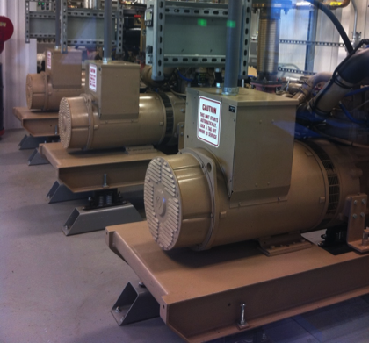
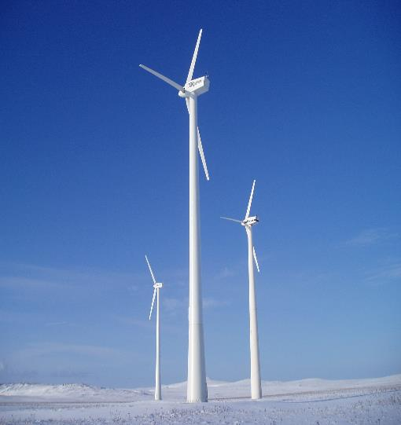
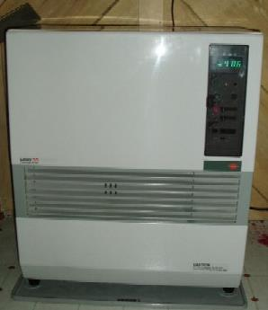
Alaska Islanded Grid Realities
High energy costs
Fragmented electric grid
Stranded resources
Diesel Generators:
Electric power in rural Alaska subsidized costs $0.50-$1.50/kWhr
Oil Stove:
Heating oil costs
$3.50 to $10/gallon
St. Paul Island Wind:
3-275 kW Vestas V17

Slide 9
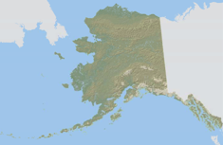
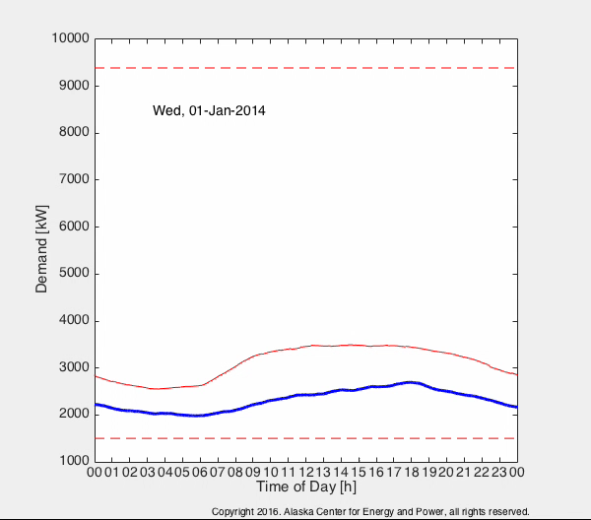
Cordova: Hydroelectric
Current: Seasonal diesel off with hydroelectric;
Future: + battery energy storage (RADIANCE)
Seasonal variability: resources and demand
Lost potential (spilled hydro)
Load levelling / peak shifting
Energy storage (RADIANCE)
Seasonal Demand Swing – Cordova, AK
Images: Inflatable hydroelectric dam at Powercreek
Cordova Energy Mix (2011): 18 GWh Hydropower,10 GWh Diesel
781,000 Gal Diesel @ $3.55/gal = $2.77M Fuel bill
Cost of generation: Hydro: ~$0.06/kWh, Diesel: ~$0.35/kWh
Estimate: 3.8 GWh spilled hydro
Can some of the spilled hydro be recovered to displace diesel fuel?

Slide 10
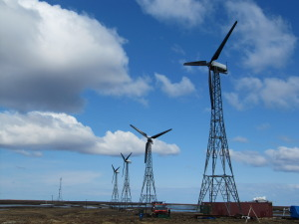
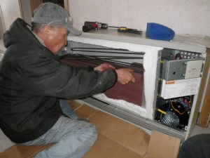
Kongiginak: Wind → Heat System
Diesel off with wind + energy storage + distributed heating
20+ thermal electric stoves installed in elder and low income homes
5 – 95 kW Windmatic direct drive turbines (30-40% wind penetration annually)
VIDEO: https://www.youtube.com/watch?v=90n9ga3SOQQ

Slide 11
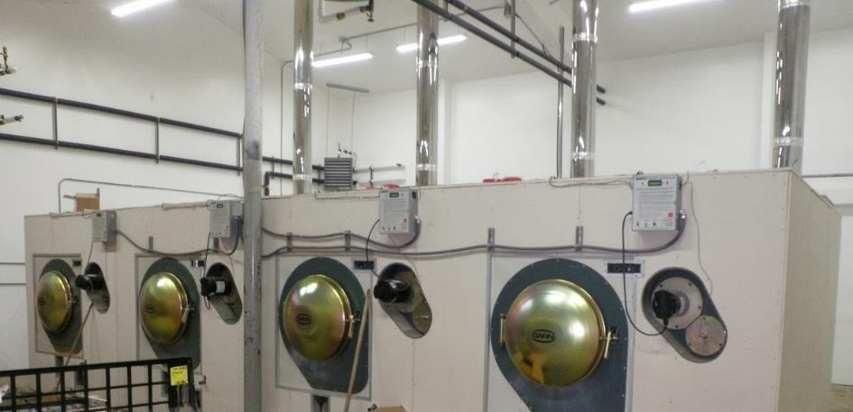
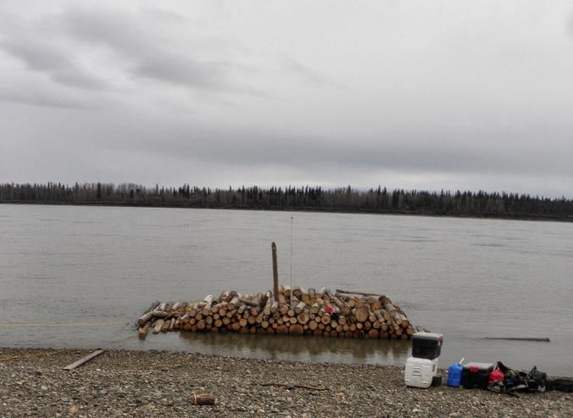
Tanana: Biomass District
Heating System
Woody biomass + biomass boiler + district heating
District heating:
Current: community buildings
Future: greenhouses
Images: Top left: woody biomass boiler; Bottom right: woody biomass delivered and sold to community by residents along river

Slide 12
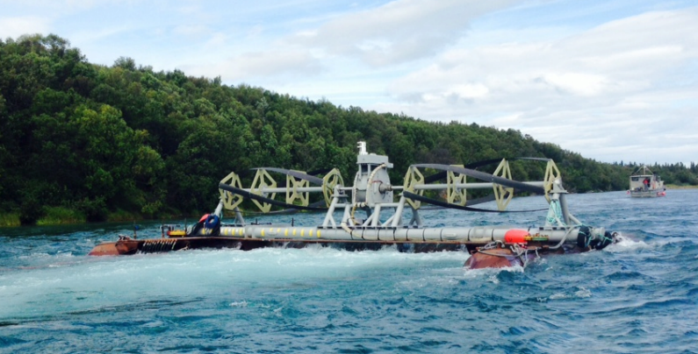
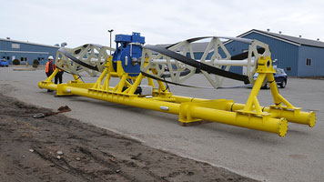
Igiugig: Hydrokinetic Project
Diesel electric + Hydrokinetic
Diesel Powerhouse
Ocean Renewable Power Company (75 kW Gorlov Turbine)

Slide 13
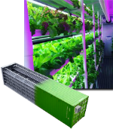
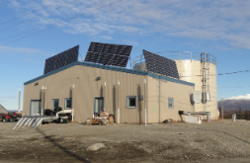
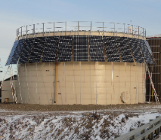
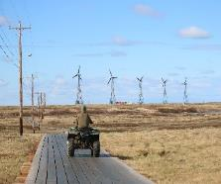
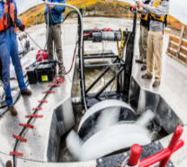
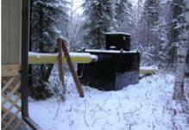
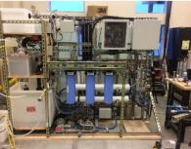
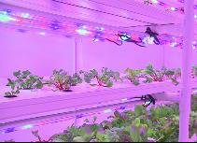
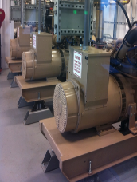
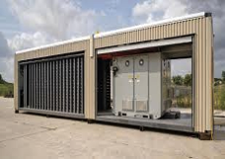
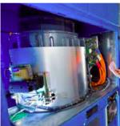
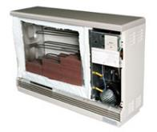
MicroFEWS Energy Distribution Model (EDM)
DISPATCHABLE AND INTERUPTIBLE LOADS
INTERMITTENT RENEWABLES
Hydrokinetic
(In-River)
Food Production
Water Treatment
Modular Systems
Solar PV
Wind
MODULAR SYSTEM LOADS
Lifewater Wastewater Treatment Module (350 W Max)
UAA In-home Water Reuse System (1.0 kW Max)
CropBox Hydroponic Module (14 kW Max)
FIRM ENERGY SOURCES
Diesel Electric
Hydroelectric (Dam)
OPTIMIZE
ENERGY DISTRIBUTION & DISPATCH
ENERGY STORAGE SYSTEMS
Inverter
Battery
Flywheel
Electric Thermal Heaters
Photo Credit: Steffes Corporation

Slide 14
Parameters for EDMs

Slide 15
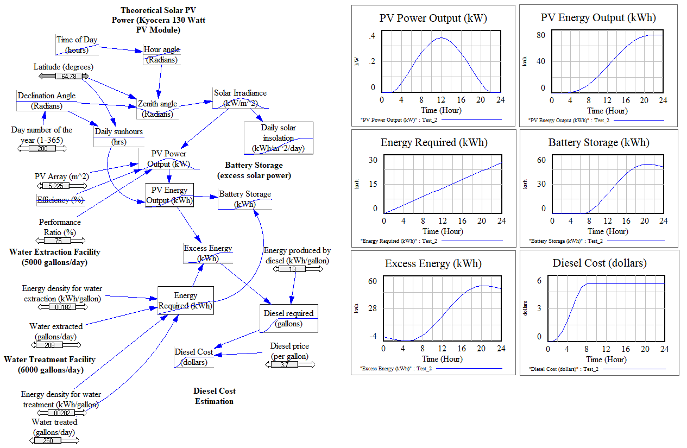
Example 1: Solar PV + Diesel + Battery → Water Treatment (250 gal/day)
Water Extracted: 208 gal/day
Water Treated: 250 gal/day

Slide 16
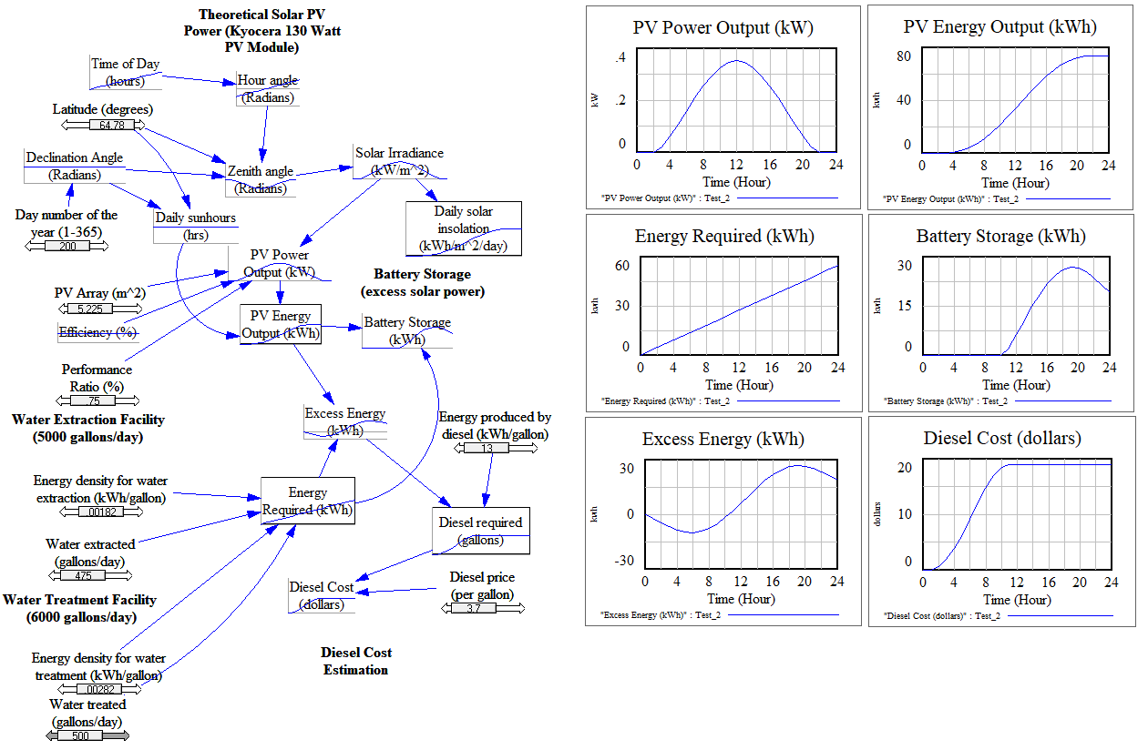
Example 1: Solar PV + Diesel + Battery → Water Treatment (500 gal/day)
Water Extracted: 475 gal/day
Water Treated: 500 gal/day

Slide 17
Example 2: Wind + Diesel → Modular Loads (Water Reuse + CropBox)

Slide 18
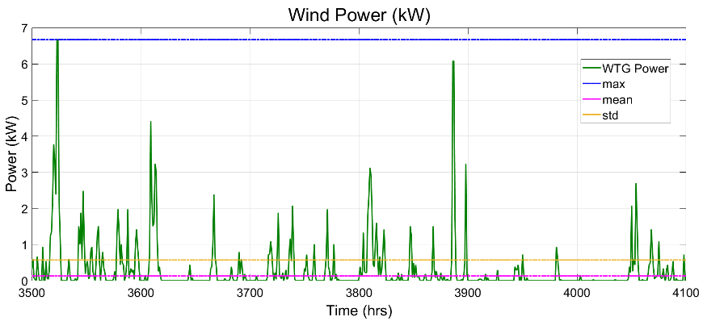
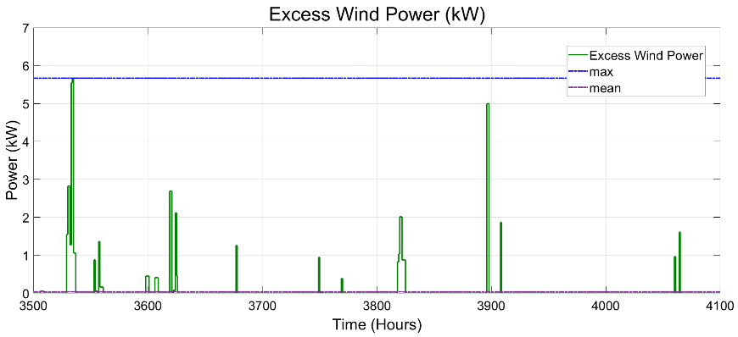
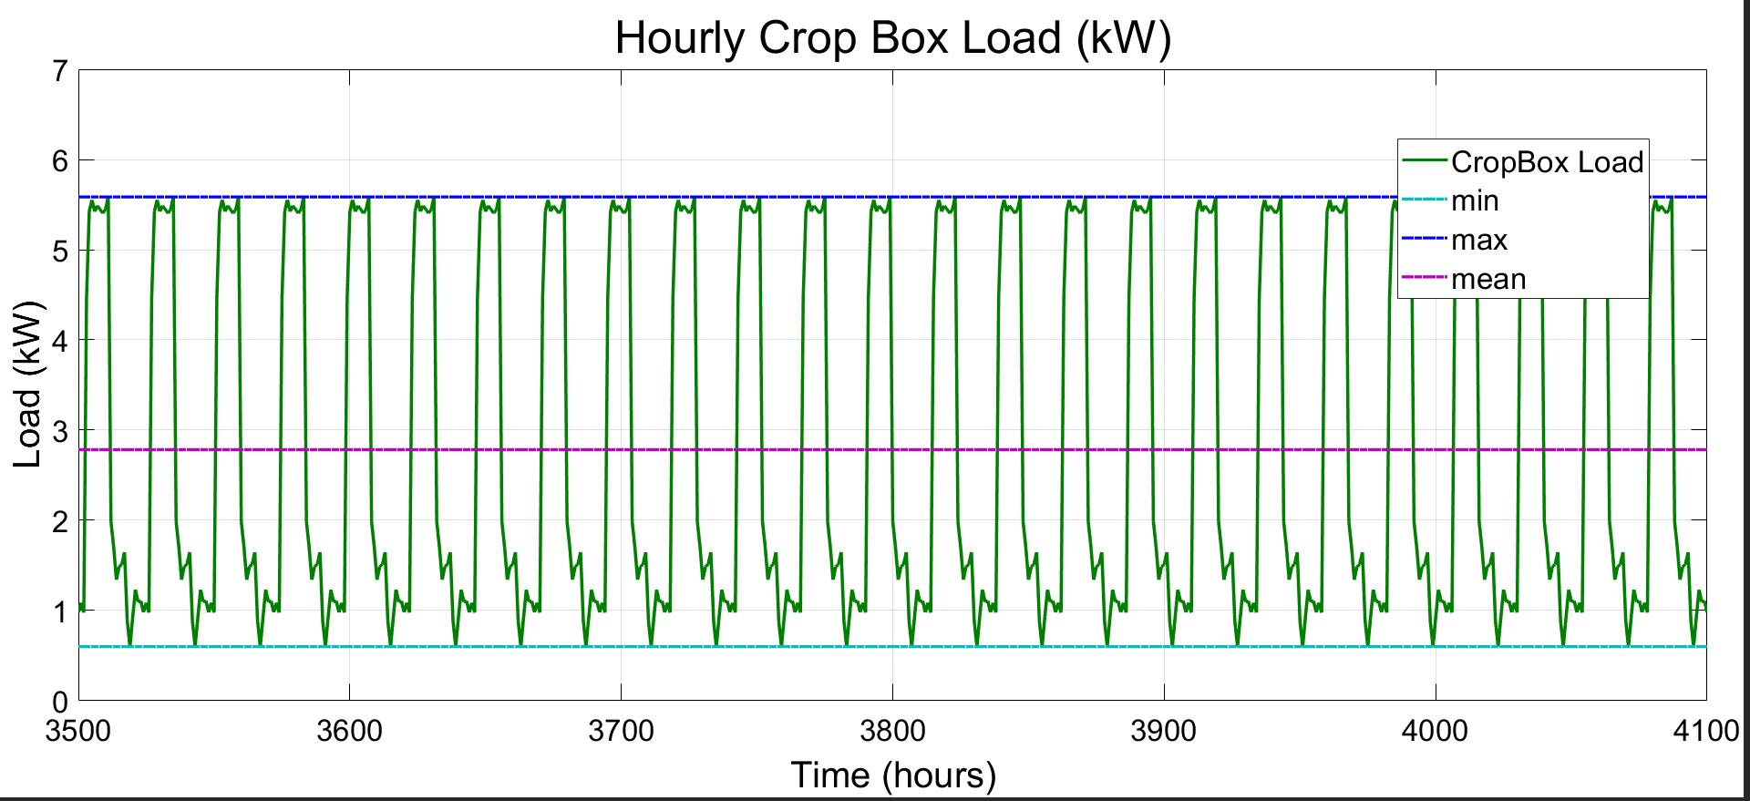
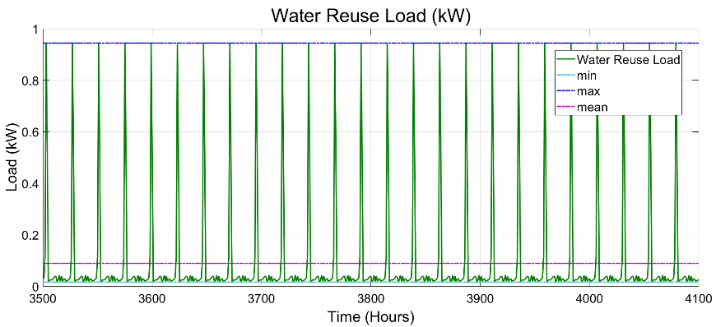
Example 2: Wind + Diesel → Modular Loads (Water Reuse + CropBox)

Slide 19
Example 3: Passive Solar + Diesel → Greenhouse

Slide 20
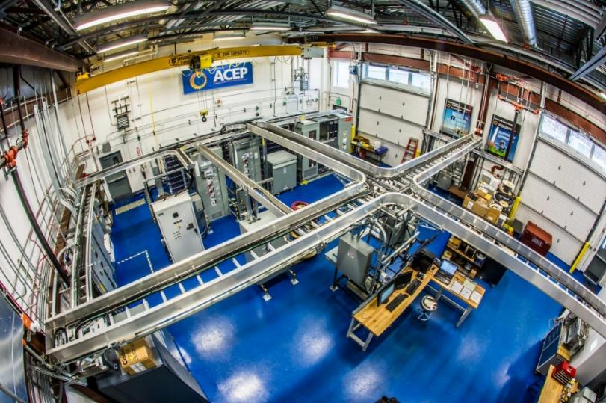

Laboratory Testing and Validation of EDMs
Bench Testing: Water Treatment
Modular Loads: Water Reuse, CropBox, Lifewater
Power Systems Integration Laboratory: FEW Scenarios
Power System Integration Laboratory:
320 kW Cat C-15 diesel, w/ Woodward EasyGen 3200
100 kW Wind Turbine Simulator (induction)
100 kW Solar PV Simulator w/ 25 kW Fronius Inverter
313 kW ABB PCS100 Inverter
540 VDC/1000 Ah Absolyte VRLA Battery
Two 250 kW, 200 kVar LoadTech Loadbanks
1000+ channel custom data collection

Slide 21
Status and Path Forward
Communities (Remote Islanded Microgrids)
Stakeholder meeting and community visits ✓
Document energy systems and FEW infrastructure ✓
Collect data (in progress: full year)
Energy Distribution Models and Lab Testing
Renewable Generation → Dispatchable FEW Demand
Optimize FEW connections
Test FEW components, modular systems, and scenarios
Develop FEW Infrastructure Planning Tool
Integrate EDMs with FEW Infrastructure Planning Tool

Slide 22

Thank you
For more information:
Richard W. Wies, PhD, PE
Professor
Electrical and Computer Engineering
College of Engineering and Mines
Alaska Center for Energy and Power
University of Alaska - Fairbanks
Tel: (907) 474-7071
E-mail: rwwiesjr@alaska.edu
Friday, Dec. 14, 1:40-6pm; Poster GC53F-1007: FEW SYTEM ASSESSMENT OF ONSITE WATER REUSE IN REMOTE ALASKA, Aaron Dotson, Taylor Ferguson, Richard Wies, Erin Whitney, Christopher Pike, Amanda Setiawan
This work is supported by NSF Chemical, Bioengineering, Environmental and Transport Systems (CBET), Track 3 INFEWS program, Award # 1740075,
INFEWS/T3: Coupling infrastructure improvements to food-energy-water system dynamics in small cold region communities: MicroFEWs.

